Slide 1
EC ENGR88S: THE INTERNET AND FREE SPEECH
Week 1
Notes:
This seminar will aim to provide a detailed look at how the internet has changed political discussions surrounding free speech, from censorship to content moderation, as well as examine solutions to these new problems that many global leaders are proposing. Taught from an engineering and technology background, this class will look at both the how and the why of censorship and content moderation.

Slide 2


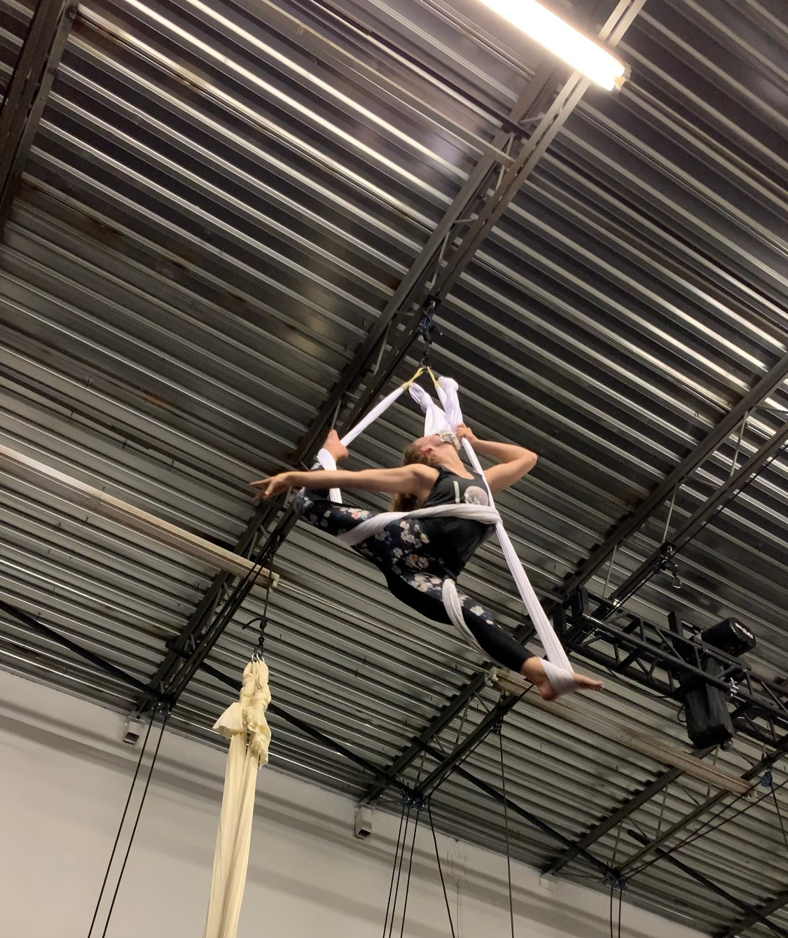
About Me
I am a fourth year bioengineering undergrad at UCLA.

Slide 3
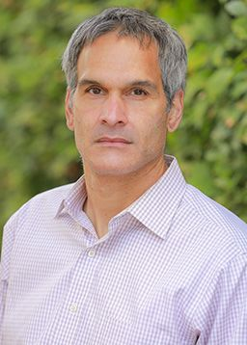
Dr. Villasenor
Director for the UCLA Institute of Technology, Law, and Policy
Professor of Electrical Engineering, Law, Public Policy, and Management
Previously with NASA Jet Propulsion Laboratory
B.S. University of Virginia, 1985
M.S. Stanford University, 1986
Ph.D. Stanford University, 1989

Slide 4
So is this course political?
Notes:
Many of these issues are very political and very sticky, and so I plan to use the beginning of each class to present factual background information, and then allow the ensuing open discussion to be opinion-based from then onwards. At that point, my role would be to prompt further discussion and maintain a respectful environment. My goal with this class is that everyone walks away with a new understanding of technology and policy, and feels more confident in their own civic engagement with these issues.

Slide 5
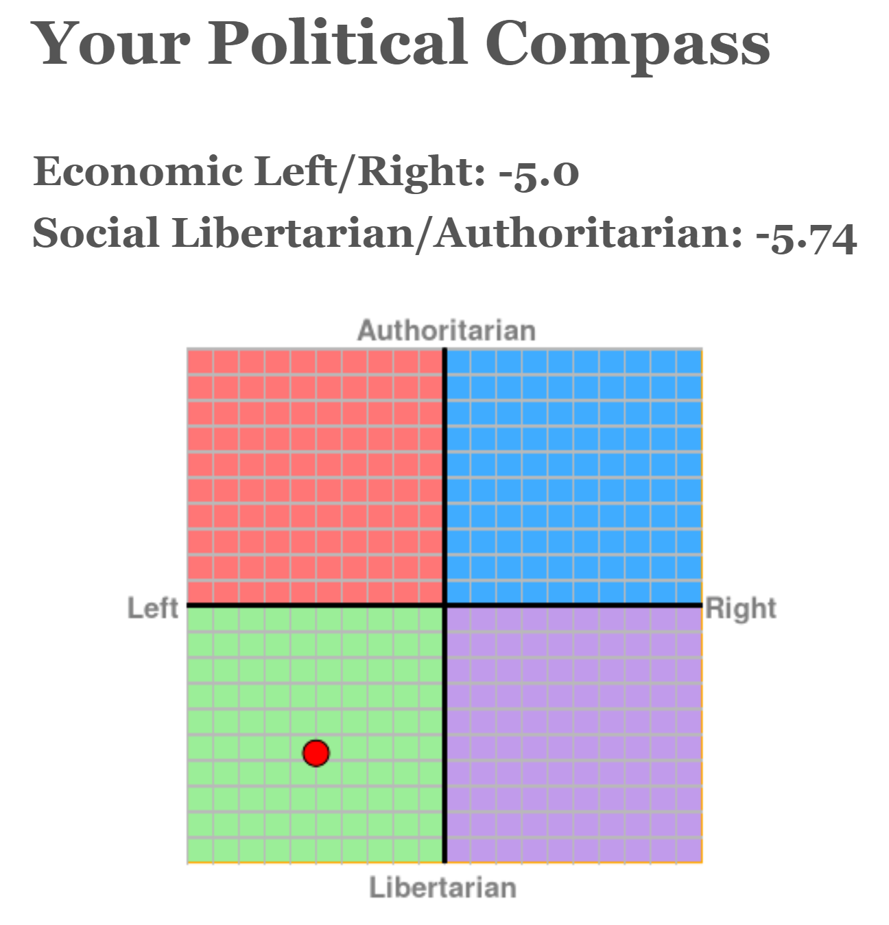
So is this course political?
Yes. And you will not be excluded, no matter your social group or political opinion.
As an instructor, I will very clearly distinguish my opinion from fact/course content.
It is everyone’s job to ensure others have a right to speak.

Slide 6
A Few Housekeeping Notes
Join the course Slack for communications and assignments (link in announcements on BruinLearn
Enable notifications
Notes about masking + Zoom
Attendance policies

Slide 7
The Ground Rules for Discussions in ECE 88S

Slide 8
The Ground Rules for Discussions in our course
Listen respectfully, without interrupting
Allow everyone a chance to speak.
Listen actively
Criticize ideas, not individuals
Commit to learning, not debating.
Avoid assumptions about any member of the class
Keep both ears open to understanding others’ views
Comment in order to share information, not to persuade.
Avoid generalizations about social groups, and do not ask individuals to speak for their (perceived) social group.
Notes:
https://crlt.umich.edu/publinks/generalguidelines
UMICH - Center for Learning –
Add publicly to this list or private chat me a suggestion that would make you feel more comfortable.

Slide 9
As well as some communication tips
Make sure you’re on the same page about certain key terms and definitions
“I” statements
Be curious about where the conversation is going.
Check your own tendency to dominate or criticize.
Restate in your own words what another person said to verify you understood what they intended
Avoid escalating in emotional intensity as much as possible

Slide 10
OUTLINE FOR TODAY
01
INTRODUCTIONS
03
PEW RESEARCH STUDY
02
GROUP POLLING ACTIVITY
04
DEFINING FREE SPEECH
Introduce yourselves!
Gauging Americans’ views
We will assess our views on censorship as a group.
Understanding the Law

Slide 11
01
INTRODUCTIONS

Slide 12
02
POLLING ACTIVITY

Slide 13
Youtube has taken down a video for encouraging violence.

Slide 14
A trans picture book has been removed from school libraries after a parent’s complaint (because they didn’t want their child to read it)

Slide 15
A panel of teachers decided not to teach the same book as last year because it is offensive or outdated.

Slide 16

A Facebook page has deleted your comment criticizing their company.

Slide 17
A publisher decided not to publish a celebrity’s book after they made certain political comments online.

Slide 18
Books about race and civil rights are disproportionately banned from prisons in the United States.

Slide 19
A librarian weeded (got rid of) a book that uses outdated terminology for a racial group.

Slide 20
Twitter removed Trump from the platform.

Slide 21
Facebook removes all content depicting sexual imagery from the platform.

Slide 22
Some posts on social media sites have a warning label on them for misleading content.

Slide 23
Republicans disproportionately have had their posts removed on social media in recent years.

Slide 24
Certain activists’ Facebook event pages organizing protests were removed from the website.

Slide 25
03
PEW RESEARCH STUDY
Notes:
Surveyed 4708 us adults from june 16 to 22, 2020. Online panel through random sampling of residential addresses (nearly all US adults had a chance at selection). Weighted to be representative of US adult population.

Slide 26
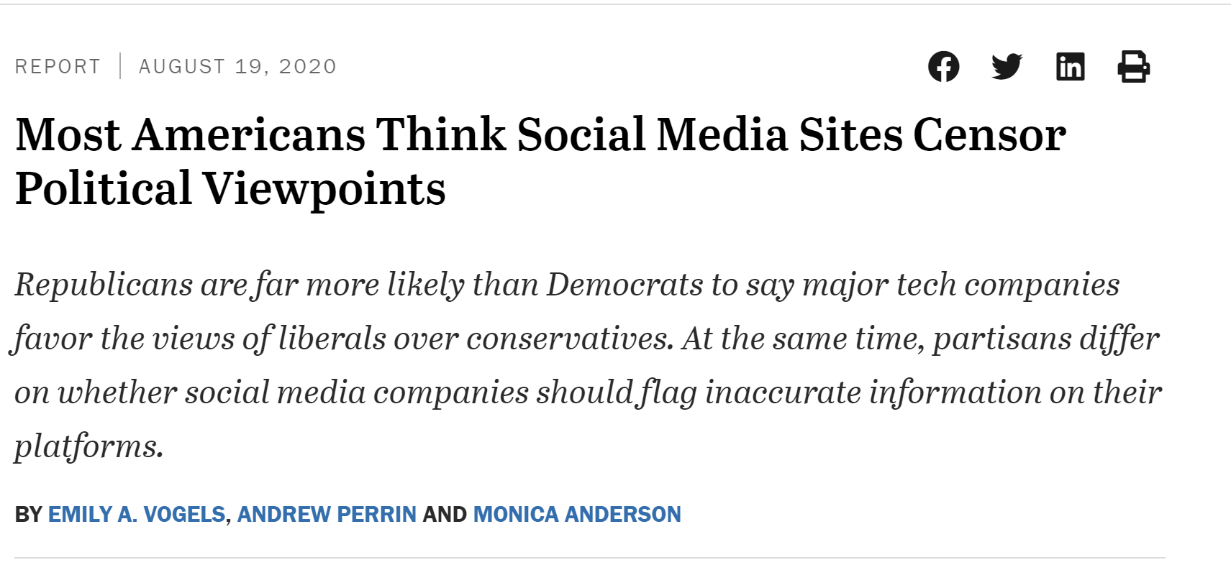
Notes:
https://www.pewresearch.org/internet/2020/08/19/most-americans-think-social-media-sites-censor-political-viewpoints/

Slide 27
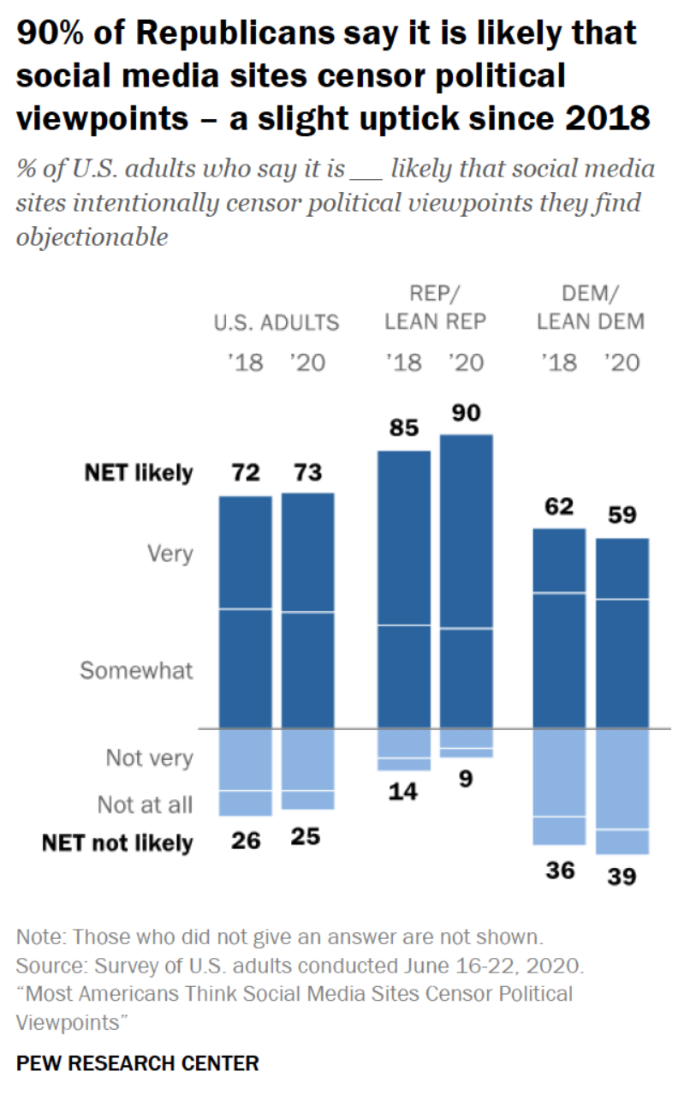
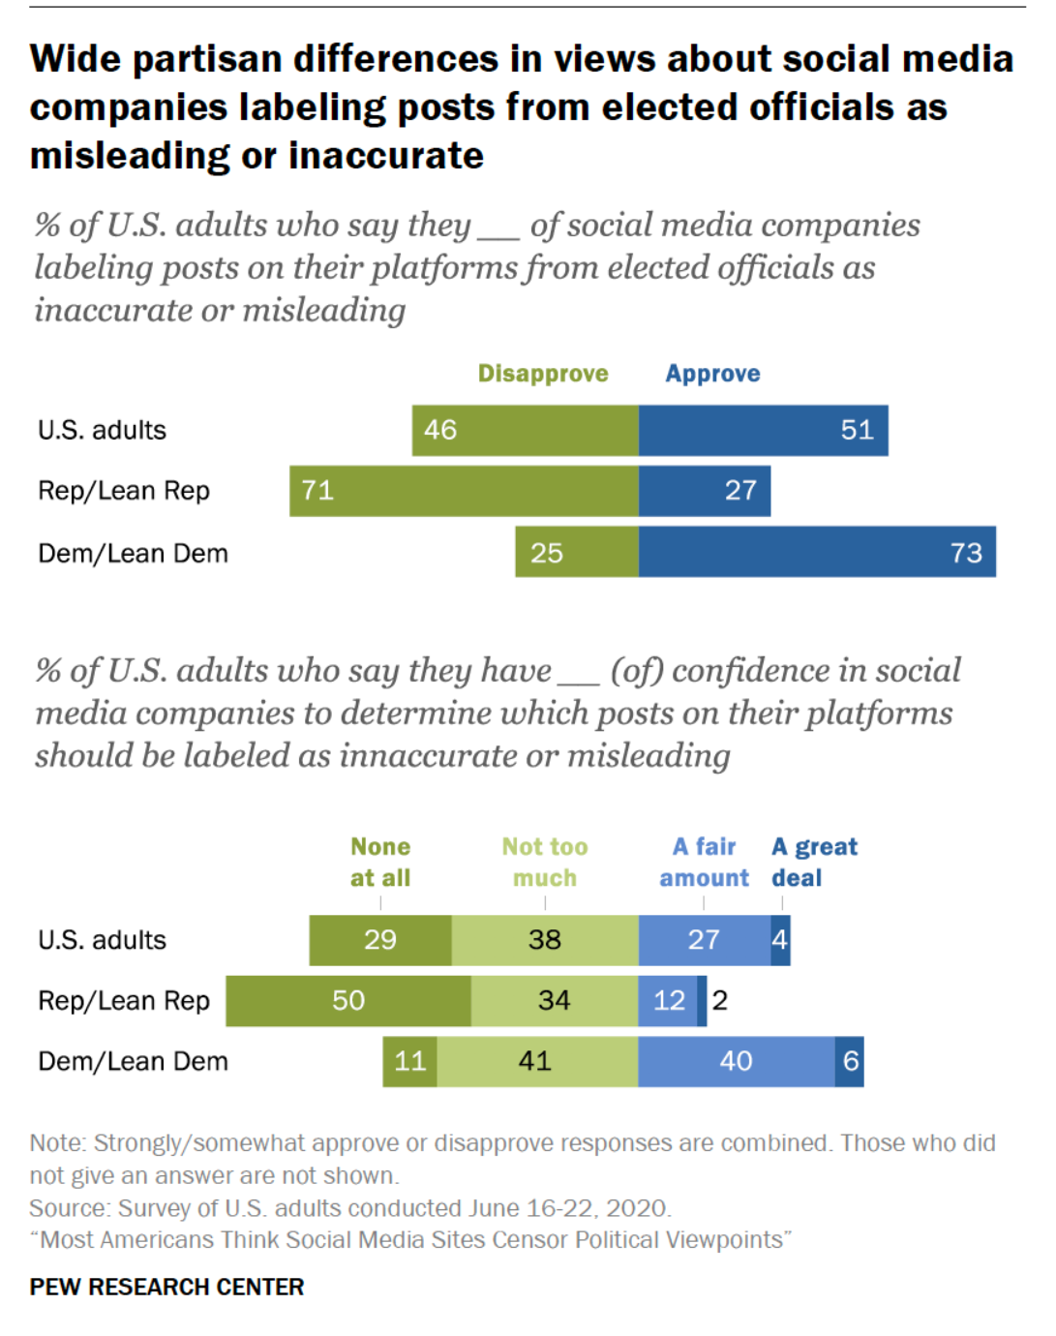

Slide 28
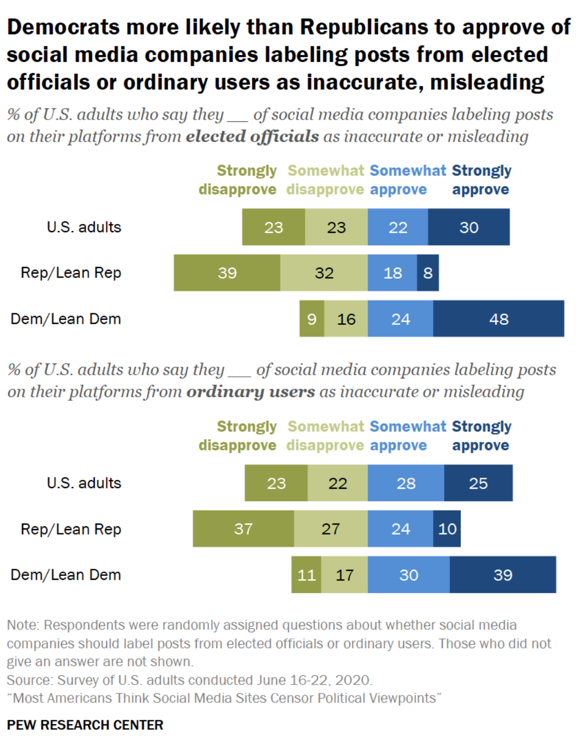
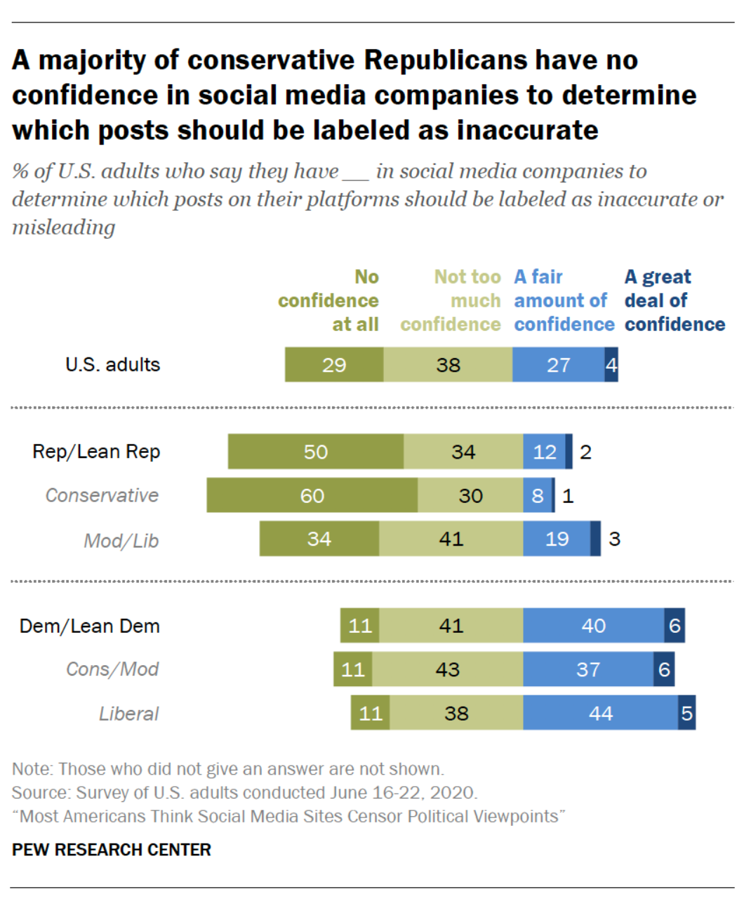

Slide 30
There’s one problem:
This isn’t censorship.

Slide 31
04
DEFINING CENSORSHIP

Slide 32
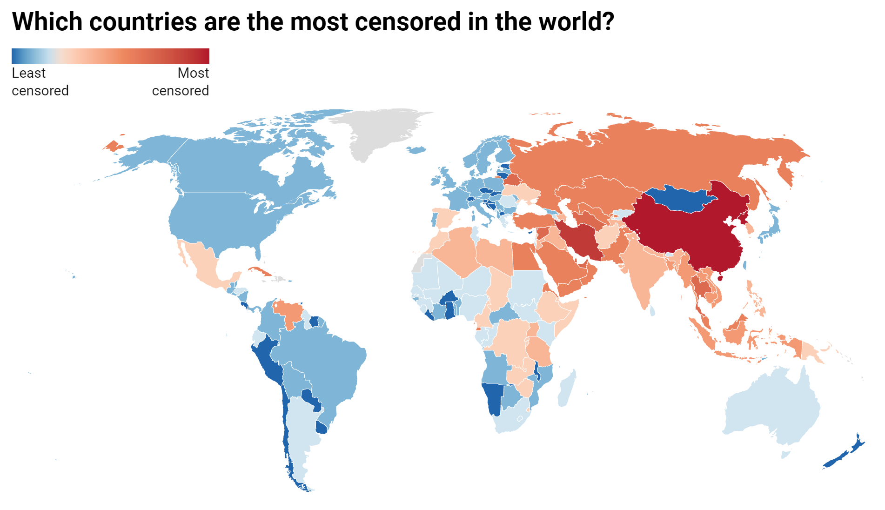
Notes:
https://www.comparitech.com/blog/vpn-privacy/internet-censorship-map/

Slide 33
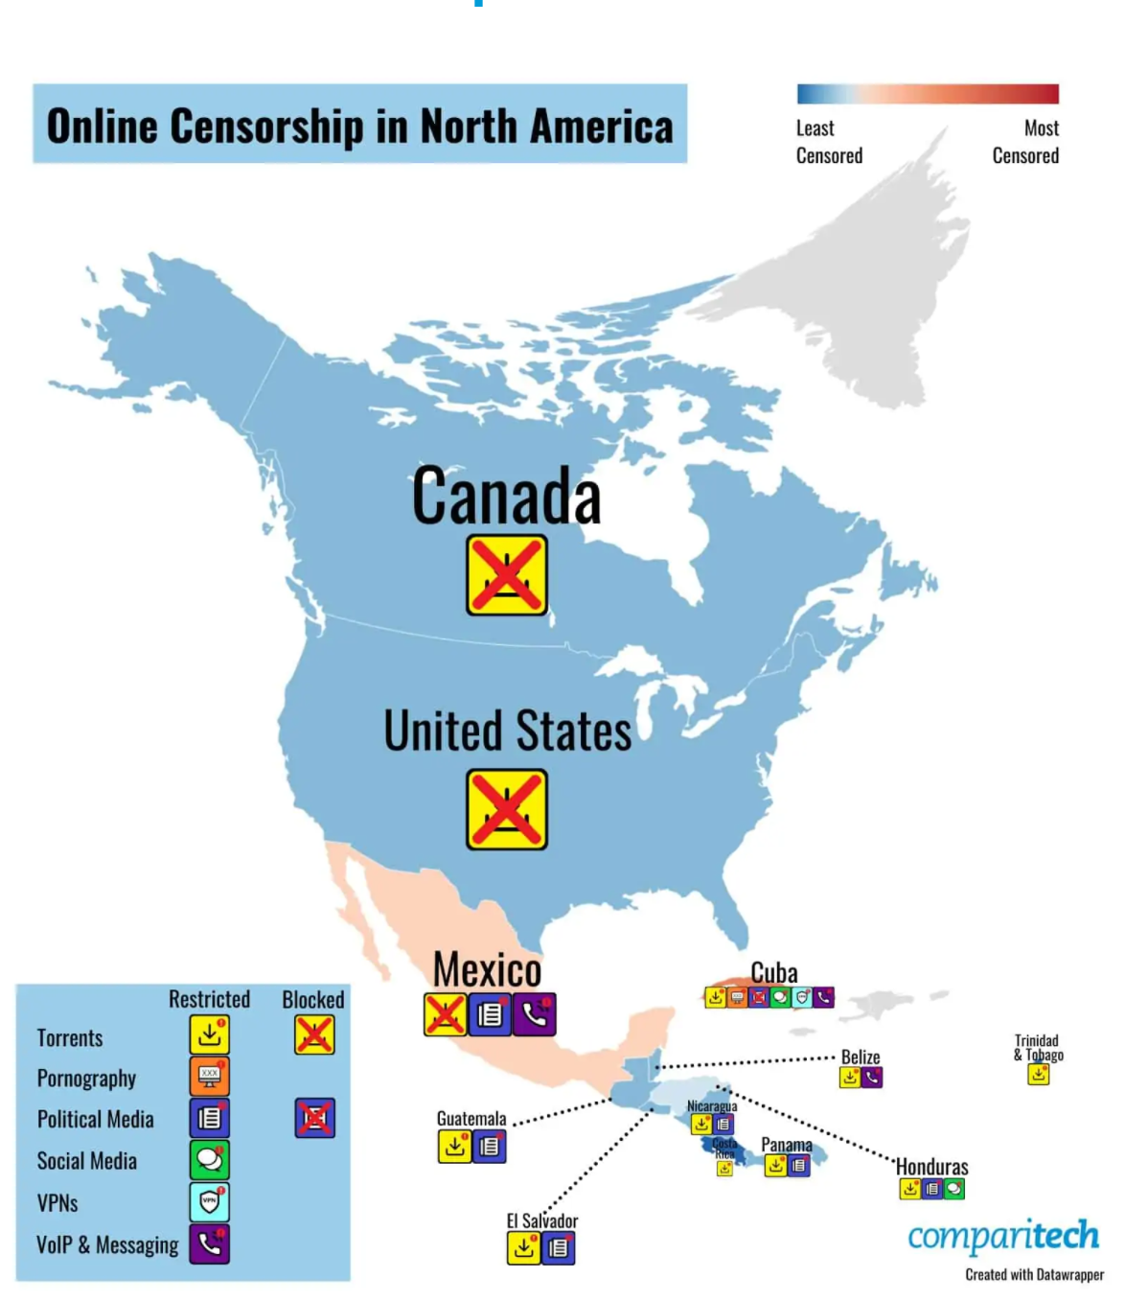
Notes:
Canada, Mexico, and the United States have banned or shut down torrenting sites.
Cuba is the only country to restrict online pornography, heavily censor its political media, and restrict VPNs.
Six other countries (El Salvador, Guatemala, Honduras, Mexico, Nicaragua, and Panama) have some restrictions across their political media. The US saw an improvement in this area this year as restrictions on political media have eased since the last presidential election.
Cuba and Honduras have restrictions across social media platforms.
Messaging and VoIP apps are met with restrictions in Belize, Cuba, and Mexico. Cuba restricted access to social media and WhatsApp following anti-government protests. In Mexico, some ISPs block VoIP services, while Belize telecoms providers offer their own VoIP services while banning others.

Slide 34
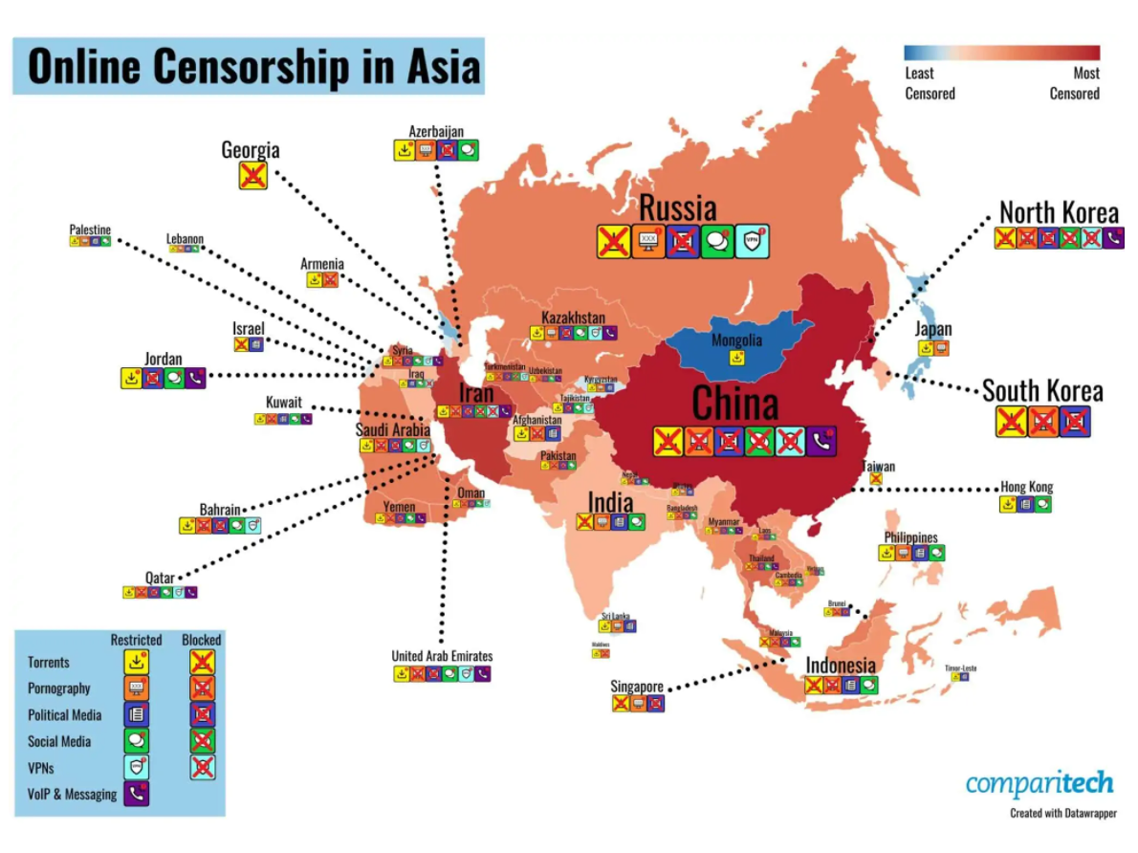
Notes:
12 Asian countries have blocked or banned torrenting sites.
The majority of Asian countries have restrictions on online pornography (40 out of the 49 we covered–82 percent) with 27 of these having full bans/blocks.
Political media is also heavily restricted and censored in Asia. 43 (88 percent) of the countries we covered have restrictions, with the majority (28) being subject to heavy censorship.
A large number (32) of these countries restrict social media platforms in some way. China, Iran, North Korea, and Turkmenistan go one step further and enforce full bans across popular social media platforms.
Four countries have full bans on VPN use (China, Iran, Iraq, and North Korea), and a further 11 impose restrictions.
Messaging and VoIP app restrictions are also commonplace in Asia with 13 countries implementing some form of limitation. Although Russia did ban Telegram in 2018, this was lifted in June 2020. However, as the government continues to look for ways to restrict websites and apps from outside the country, this could change at any time.

Slide 35
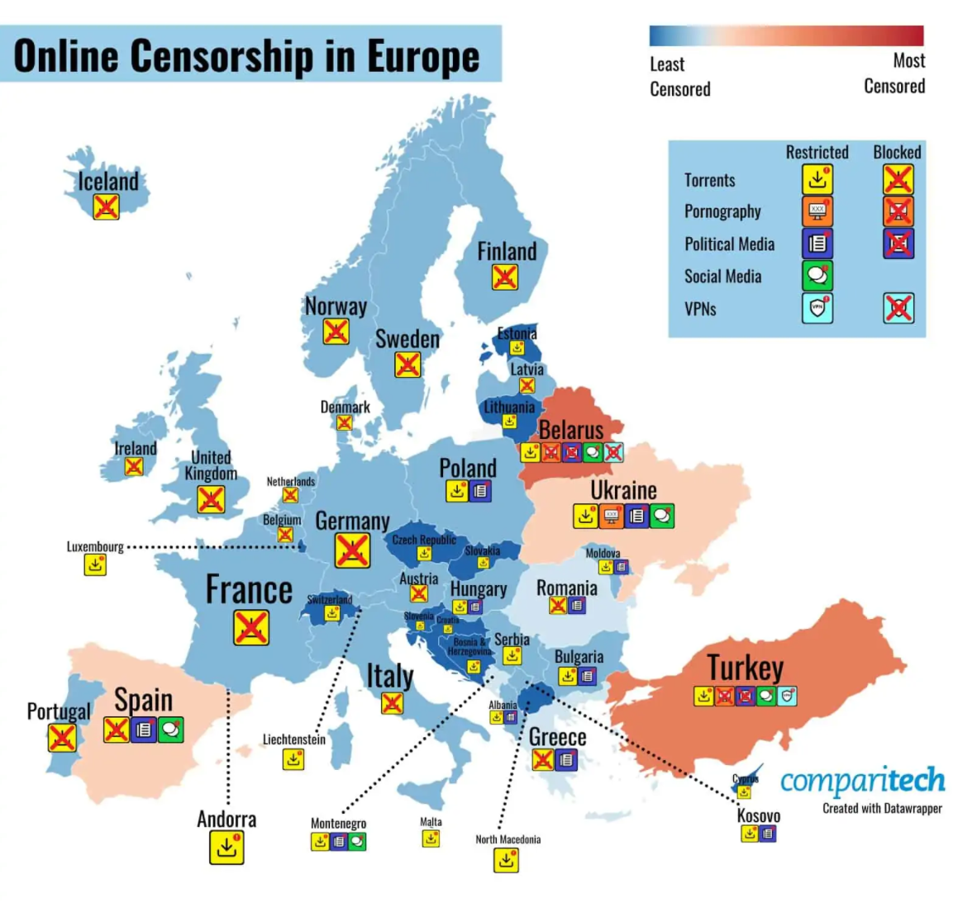
Notes:
18 countries have banned or shut down torrenting sites. A number have also introduced measures but aren’t blocking websites as of yet (Bulgaria, Croatia, Cyprus, the Czech Republic, Estonia, Hungary, Liechtenstein, Lithuania, Luxembourg, Malta, Poland, Slovakia, and Slovenia). As they aren’t blocking torrenting sites, these haven’t been scored as having “sites blocked” and are instead scored as being “restricted.”
While torrenting websites are often blocked in Spain (hence why it is classed as having shut down torrenting sites), rules do permit torrenting for personal use (downloading to view but not to upload or distribute).
Ukraine restricts online pornography while Belarus and Turkey ban/block the content entirely.
Political media is restricted in 12 countries. As we have already seen, Greece joined this list this year as did Hungary and Kosovo.
Two countries heavily censor political media – Belarus and Turkey.
No European countries block or ban social media but five do restrict it. These are Belarus, Montenegro, Spain, Turkey, and Ukraine.
Turkey restricts the use of VPNs while Belarus bans them entirely.
Messaging and VoIP apps are unrestricted across Europe.

Slide 36
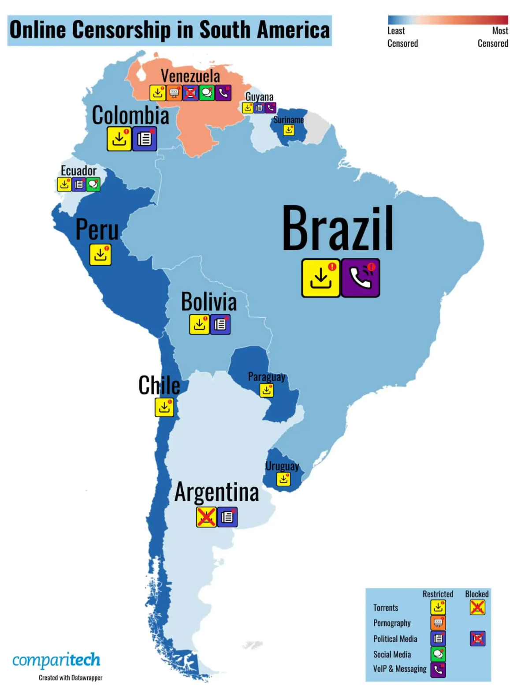
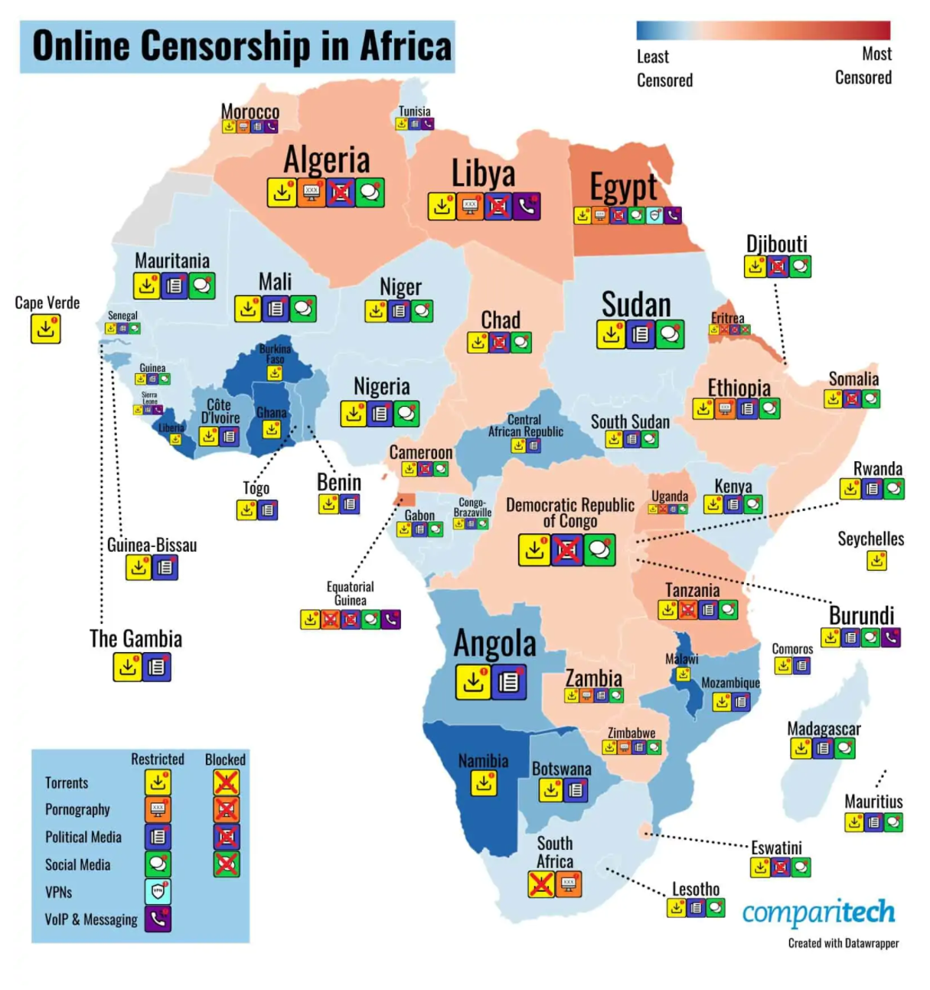
Notes:
South Africa is the only African country to actively shut down torrenting sites.
14 African countries have restrictions when it comes to online pornography with four of these having full bans (Equatorial Guinea, Eritrea, Tanzania, and Uganda). New regulations in Tanzania further defined pornography as a type of “prohibited content.”
Most of the African countries we covered (43 of 53–81 percent) restrict political media. 11 of these enforce heavy censorship with Algeria, Cameroon, and Chad all upping their suppression of political commentary since our last study.
60 percent of the African countries we covered implement social media restrictions but only one of these–Eritrea–has gone so far as to continually block access to social media sites.
Egypt is the only country to restrict VPN use. Despite VPNs being legal, many VPN providers’ websites and servers are blocked (these are the best options when choosing a VPN in Egypt).
Egypt is also one of the seven countries to have restrictions surrounding the use of messaging/VoIP apps. The others are Burundi, Equatorial Guinea, Sierra Leone, Libya, Morocco, and Tunisia.

Slide 37
Discussion for next time: Who is hurt most by censorship, and who does censorship protect?

